Slide 1
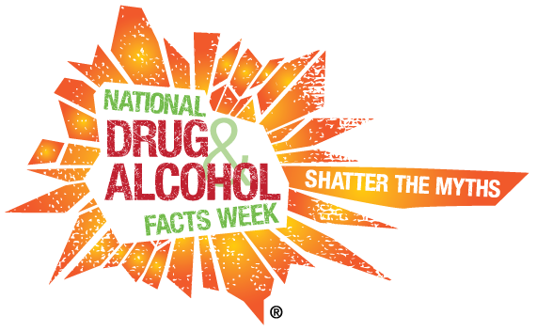
Welcome to National Drug Facts Week!
January 23-29th

Slide 2
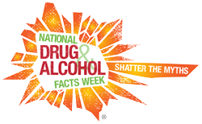
National Drug Facts Week
Did you know?
Alcohol
Abstaining from underage drinking can save an average of 4,358 lives each year.

Slide 3
National Drug Facts Week
Can drinking cause cancer?
Pop Quiz!
YES! “Drinking alcohol increases your risk of developing various cancers, including cancers of the mouth, esophagus, pharynx, larynx, liver, and breast.”

Slide 4
National Drug Facts Week
…a blackout?
What is…
“A gap in a person’s memory for events that took place while he or she was drinking. When a blackout happens, a person’s brain does not create memories for these events as they are happening.”

Slide 5
National Drug Facts Week
“Underage drinking is a serious problem, as you may have seen from your friends’ or your own experiences. Alcohol is the most commonly used substance of abuse among young people in America, and drinking when you’re underage puts your health and safety at risk.”
Did you know?

