Slide 1
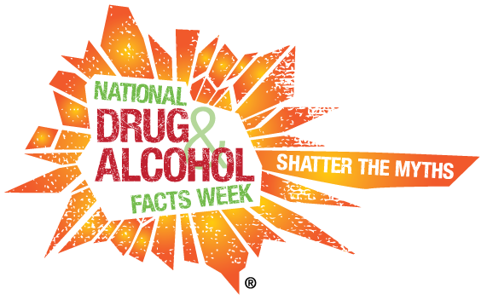
Welcome to National Drug Facts Week!
January 23-29th

Slide 2
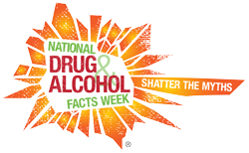
National Drug Facts Week
Did you know?
Prescription Drugs
“After marijuana and alcohol, prescription drugs are the most commonly abused substances by Americans age 14 and older.”
“When they are abused, they can be just as dangerous as drugs that are made illegally.”

Slide 3
National Drug Facts Week
True or False?
Heroine is an addictive drug made from morphine….
TRUE!!!

Slide 4
National Drug Facts Week
You can never overdose on cold medicine…..
True or false?
False!! You can overdose on cold medicine.
Symptoms of an overdose may include…
-Loss of coordination and high BP
-Faster heart beat and numbness
-Possible Death

Slide 5
National Drug Facts Week
According to a 2016 study, on average, how many 10th graders have used Heroin in their lifetime?
Pop Quiz!
20%
3%
6%
15%

Slide 6
National Drug Facts Week
According to a 2016 study, on average, how many 10th graders have used Heroin in their lifetime?
Pop Quiz!
20%
3%
6%
15%

